Slide 1
Data Warehouse Design to Support Customer Relationship Management Analyses
Colleen Cunningham, Il-Yeol Song and Peter Chen
DOLAP ‘04
November 12, 2004

Slide 2

Agenda
Background
Motivation
Methodology
Results
Areas for future research
Contributions & Conclusions
Q & A

Slide 3
Agenda
Background
  CRM Definition
  Why Use CRM?
  Customer Lifetime Value (CLV)
Motivation
Methodology
Results
Areas for future research
Contributions & Conclusions
Q & A

Slide 4
CRM Definition
Proactive strategy
  Utilizes organizational knowledge
  Utilizes technology
Support profitable long-term relationships with customers

Slide 5
Why Use CRM?
All customers are not equal
More expensive to acquire new customers than it is to retain customers
Repeat customers can generate more than twice as much gross income as new customers
Notes:
Companies are turning to CRM because they realize that not all customers are equal, which means that it is more effective and profitable to invest in profitable or potentially profitable customers than it is to invest in non-profitable customers.
Additionally, it can cost 5 times more to acquire new customers than it costs to retain existing customers; and existing customers can typically generate more revenue than new customers.
By utilizing a DW, a company can analyze its customers’ historic and future values in order to segment its customer base, and subsequently select the appropriate strategy for managing specific customer relationships.

Slide 6
Customer Lifetime Value (CLV)
CLV = Historic value + Potential Future value
  Historical Value = Σ^{N}_{j=1} (Revenue_{j} - Cost_{j}) j: individual products that the customer has purchased
  Potential Future Value = Σ^{N}_{j=1} (Probability_{j} X Profitability_{j})
j: individual products that the customer could potentially purchase
Notes:
By utilizing a DW, a company can analyze its customers’ historic and future values in order to segment its customer base, and subsequently select the appropriate strategy for managing specific customer relationships.
The historical value is computed by summing the difference between the revenue and total cost over every product (j) that the customer has purchased in the past. The cost would include such things as product cost, distribution cost, overhead cost, etc.
Profitability equals expected revenues minus the sum of the expected costs that would be incurred in order to gain the additional revenues.

Slide 7
Customer Lifetime Value (CLV)
Use customers’ Lifetime Value (CLV) to classify customers
Table 1: Customer Segments
Historic Value
Low
High
Future Value
High
II. Re-Engineer
IV. Invest
Low
I. Eliminate
III. Engage

Slide 8
Customer Lifetime Value (CLV)
Table 2: Corresponding Segmentation Strategies
Historic Value
Low
High
FV
High
Up-sell & cross-sell activities and add value
Treat with priority and preferential
Low
Reduce costs and increase prices
Engage customer to find new opportunities in order to sustain loyalty

Slide 9
Agenda
Background
Motivation
  Overview
  New Metrics
Methodology
Results
Areas for future research
Contributions & Conclusions
Q & A

Slide 10
Motivation
The DW directly impacts a company’s ability to perform analytical CRM analyses
50% - 80% of CRM initiatives fail
(Myron and Ganeshram 2002; Panker 2002)
Systematically examine CRM factors that affect design decisions for DWs in order to:
  Build a taxonomy of CRM analyses
  Develop heuristics for CRM DW design decisions
  Create metrics to objectively evaluate CRM DW models
Notes:
In terms of our motivation for doing this study…The design of the CRM DW model can contribute to the success or failure of CRM. In fact, it has been reported that between 50% - 80% of CRM initiatives fail due to either inappropriate or incomplete CRM processes and poor selection of technologies (Myron and Ganeshram 2002; Panker 2002). However, there are no agreed upon standardized rules for how to design data warehouses to support CRM analyses.
Therefore, we wanted to systematically examine…..all of which could be used to help guide successful CRM initiatives.

Slide 11
New Metrics
  % Success Ratio (r_{success}) = Q_{p} / Q_{n}
    Q_{p}: the total number of analyses that the model could successfully handle
    Q_{n}: the total number of analyses issued against the model
    It measures the “robustness” of the model
Notes:
“Successfully executed” means that the model is capable of handling the question that the user wants answered

Slide 12
New Metrics
  CRM Suitability Ratio (r_{suitability}) = Σ^{N}_{i=1}(X_{i}C_{i}) / N
    N: the total number of applicable analysis criteria
    C: individual score for each analysis capability
    X: weight assigned to each analysis capability
    It measures the “appropriateness” of the model for a specific company
Notes:
The intended use of this metric is to help a company select the appropriate model to meet its needs

Slide 13
Agenda
Background
Motivation
Methodology
  Identify Minimum Requirements
  Preliminary Starter Model for CRM DW
  Implementation
  Evaluation of Model
Results
Areas for future research
Contributions & Conclusions
Q & A

Slide 14
Methodology Overview
Identify categories of analyses
Identify specific analyses & KPIs
Categorize the specific analyses & KPIs
Identify specific data points
Design the CRM starter model
Implement the CRM starter model
Continue collecting additional analyses
Randomly select analyses to run
Evaluate the model

Slide 15
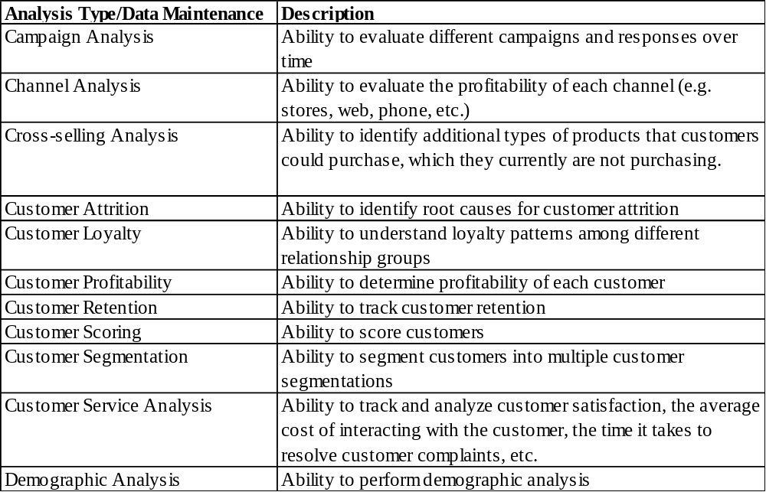
Minimum Design Requirements for CRM DWs
Table 3: Minimum Design Requirements for CRM Data Warehouse

Slide 16
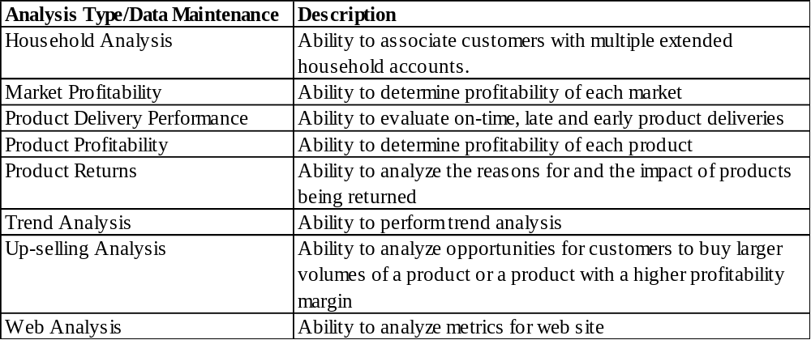
Minimum Design Requirements for CRM DWs
Table 3: Minimum Design Requirements for CRM Data Warehouse (Continued)

Slide 17
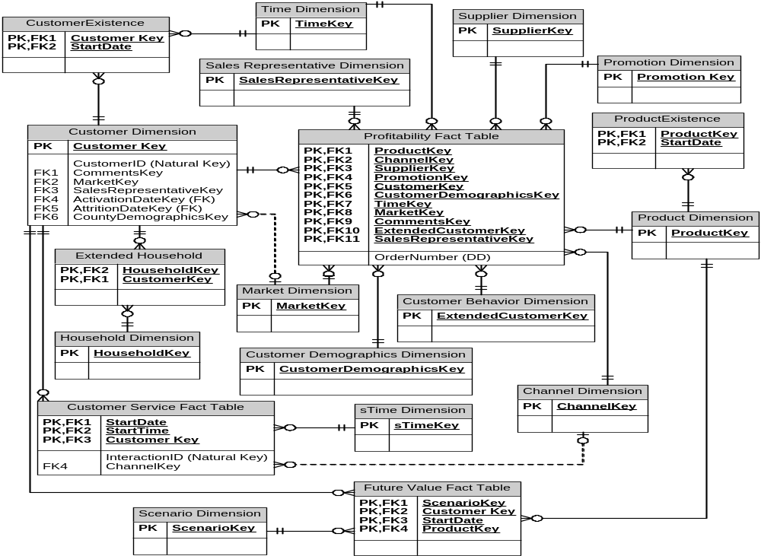
Preliminary starter model for CRM DW

Slide 18
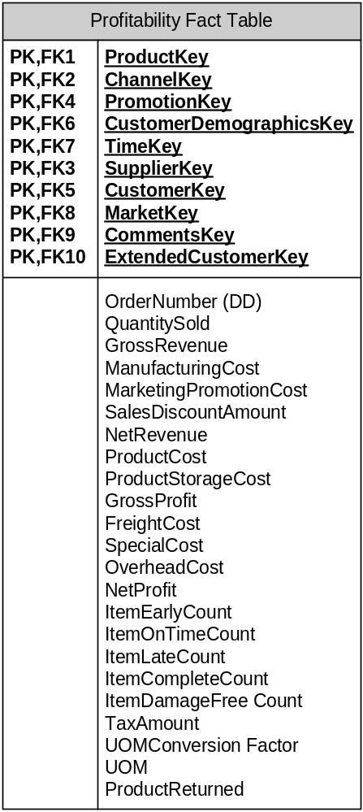
Preliminary starter model for CRM DW
Profitability for any transaction in the fact table can be calculated as follows:
  Gross Profit = Gross Revenue – Manufacturing Cost – Marketing Cost – Product Storage Cost
  Net Profit = Gross Profit – Freight Cost – Special Cost – Overhead Cost
  Gross Margin = Gross Profit/Gross Revenue

Slide 19
Implementation
Operating System: Windows 2000 Server
DBMS: SQL Server 2000
Hardware: DELL 1600 database server, single processor, 2.0 MHz
Fact tables contained 1,685,809 records

Slide 20
Evaluation of Model
A series of randomly-selected CRM queries were executed against the proposed data warehouse schema
The metrics were computed
  % Success Ratio (r_{success})
  CRM Suitability Ratio (r_{suitability})

Slide 21
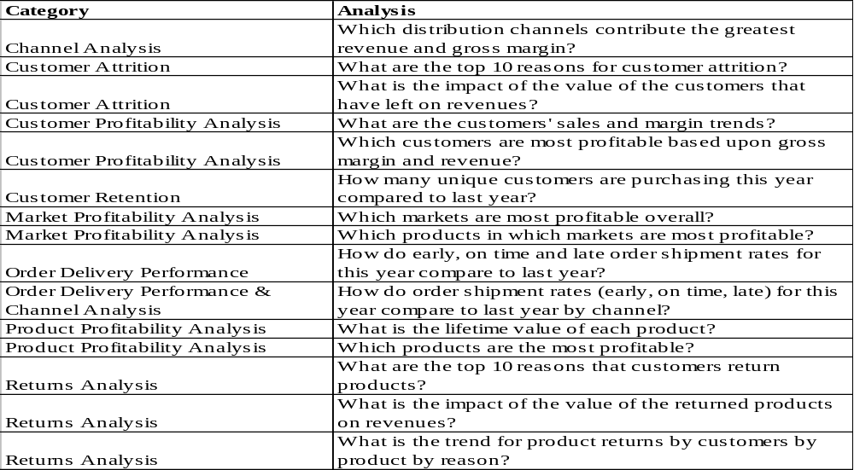
Evaluation of Model
Table 4: Sample CRM Analyses

Slide 22
Evaluation of Model: Sample Queries
SELECT c.Year, b.MarketKey, b.LocationCode, b.Location, b.Description, b.CompetitorName, d.ProductCode, d.Name, Sum(a.GrossRevenue) AS TotalRevenue, Sum(a.GrossProfit) AS TotalGrossProfit, TotalGrossProfit/TotalRevenue AS GrossMargin
FROM tblProfitabilityFactTable a, tblMarket b, tblTimeDimension c, tblProductDimension d
WHERE b.MarketKey=a.MarketKey And a.TimeKey=c.TimeKey And a.ProductKey=d.ProductKey
GROUP BY c.Year, b.MarketKey, b.LocationCode, b.Location, b.Description, b.CompetitorName, d.ProductKey, d.ProductCode, d.Name, b.MarketKey
ORDER BY Sum(a.GrossRevenue) DESC;
SELECT b.CustomerKey, b.CustomerName, Sum(a.GrossRevenue) AS TotalRevenue, Sum(a.GrossProfit) AS TotalGrossProfit, TotalGrossProfit/TotalRevenue AS GrossMargin
FROM tblProfitabilityFactTable a, tblCustomer b
WHERE b.CustomerKey=a.CustomerKey
GROUP BY b.CustomerKey, b.CustomerName
ORDER BY Sum(a.GrossRevenue) DESC;
Figure 1: Customer Profitability Analysis Query - Which customers are most profitable based upon gross margin and revenue?
Figure 2: Product Profitability Analysis Query - Which products in which markets are most profitable?
Notes:
Figure 2 could be used to determine the margins for each product, and subsequently used to identify products that potentially may be eliminated from the company’s product line. The ability to be able to determine the lifetime value of each product (irrespective of market) by merely modifying the SQL statement in Figure 3 to exclude the product code further illustrates the flexibility and robustness of the proposed CRM model .

Slide 23
Agenda
Background
Motivation
Methodology
Results
  Initial Taxonomy of CRM Queries
  Initial Heuristics for CRM DW Design Decisions
Areas for future research
Contributions & Conclusions
Q & A

Slide 24
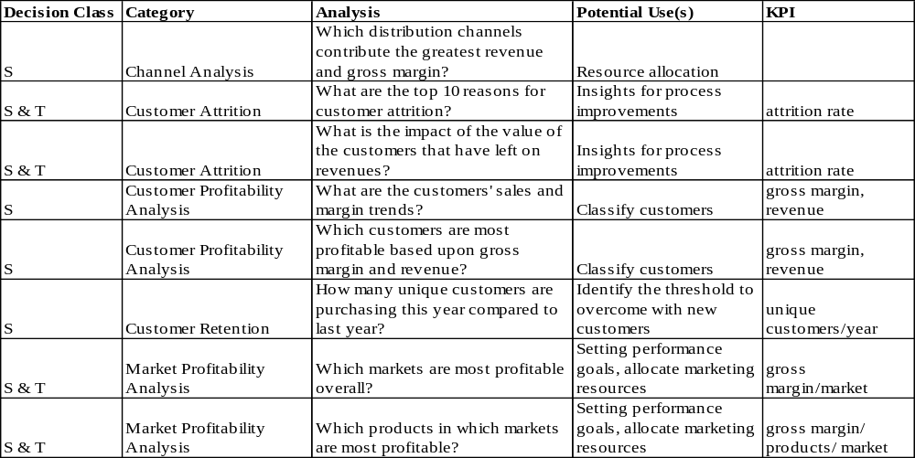
Initial Taxonomy of CRM Analyses
Table 5: Initial Taxonomy of CRM Analyses (S=Strategic and T=Tactical)

Slide 25
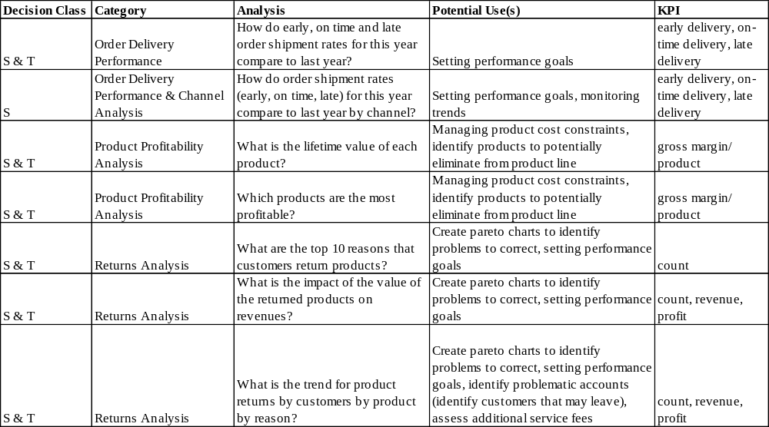
Initial Taxonomy of CRM Analyses
Table 5: Initial Taxonomy of CRM Analyses (S=Strategic and T=Tactical) (Continued)

Slide 26
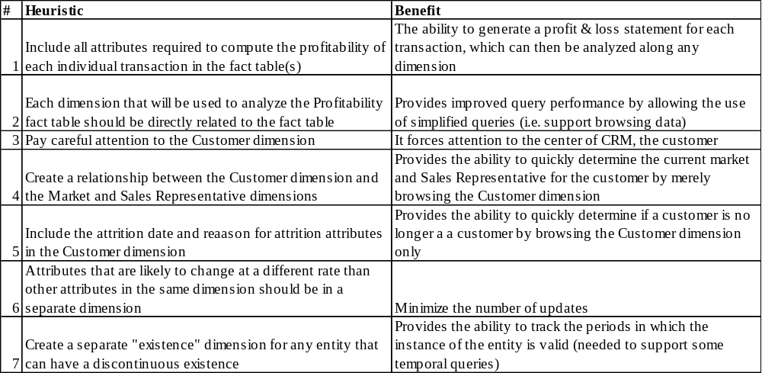
Initial Heuristics for DW Design Decisions
Table 6: Initial Heuristics for Designing CRM DWs

Slide 27
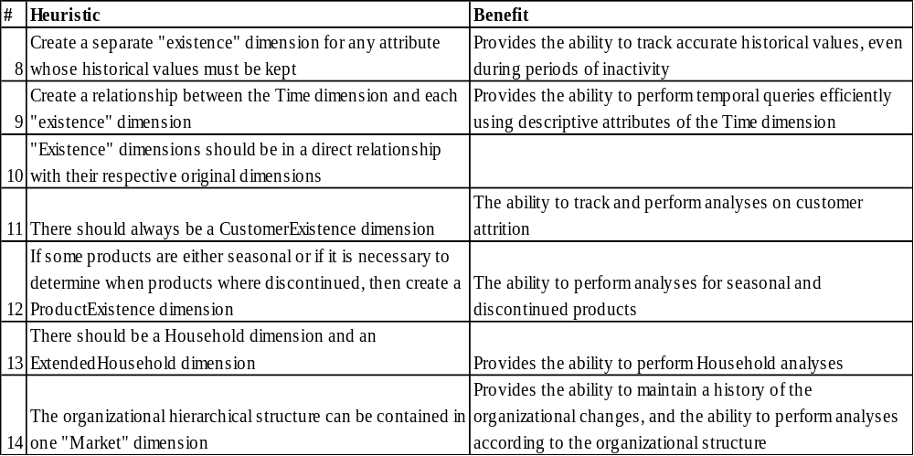
Initial Heuristics for DW Design Decisions
Table 6: Initial Heuristics for Designing CRM DWs (Continued)

Slide 28
Agenda
Background
Motivation
Methodology
Results
Areas for future research
Contributions & Conclusions
Q & A

Slide 29
Areas for Future Research
Compile & categorize additional queries and KPIs that are relevant to CRM
Develop a taxonomy for DW schemas by industry
  Which schemas are best suited for which types of analyses?
Compare alternative models

Slide 30
Areas for Future Research
Develop data mining techniques that can be utilized with the starter model
Efficiently build aggregation and cube for MOLAP
  Construction rules

Slide 31
Areas for Future Research
Effective use of materialized views in ROLAP
  What types to create?
  How to tune?
  How to evolve?

Slide 32
Contributions
Starter model for CRM
Taxonomy of CRM queries and their uses, including KPIs
Heuristics for designing a data warehouse to support CRM
Sampling Technique
New Evaluation Metrics
  % Success Ratio = Total Passed / Number of Queries
  CRM Suitability Ratio = Total Score/Total # of criteria

Slide 33
Conclusions
Our starter model can be used to analyze various CRM analyses:
  customer profitability analysis,
  product profitability analysis,
  channel profitability analysis,
  market profitability analysis,…

Slide 34
Agenda
Background
Motivation
Methodology
Results
Areas for future research
Contributions & Conclusions
Q & A

Slide 35
Q & A
Thank You!
Contacts
  Colleen Cunningham: cmc38@drexel.edu
  Dr. Il-Yeol Song: song@drexel.edu

